Slide 1
THE TECHNOLOGY INDUSTRY REVOLUTION
Science and technology revolutionize our lives, but memory, tradition and myth frame our response. - Arthur Schlesinger (Historian)

Slide 2
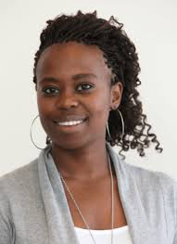
LORETTA MAGAGULA
Incitech Co-Founder.
Head of Research and Development.
Developed an HIV home testing kit.
The HIV home-testing kit will combine existing technologies in the form of a skin patch that changes colour depending on the tester’s HIV status.
Does things for the greater good.
Tertiary Education:
BSc Biochemistry and Molecular Biology and Physiology.
BSc Hons, Biotechnology.
MSc, Clinical Science and Immunology.

Slide 3
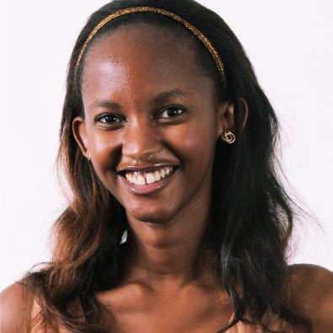
DANISA NKUNA
Chief Executive Officer, Incitech.
Strategy and Innovation Specialist.
The HIV home-testing kit will combine existing technologies in the form of a skin patch that changes colour depending on the tester’s HIV status.
Passionate about making health care accessible to all.
Project: New market development.
Tertiary Education:
Industrial Engineering degree.
Master of Management in Innovation and Entrepreneurship.

Slide 4
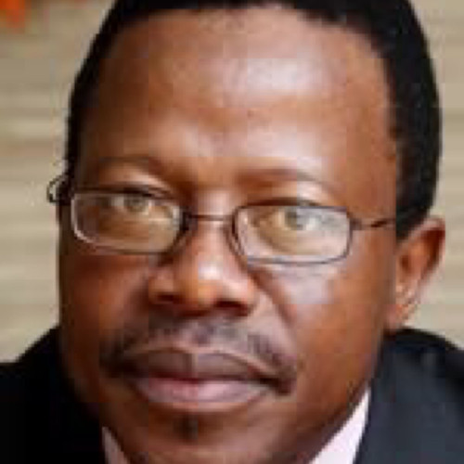
JUNIOR JOHN NGULUBE
Chief Executive Officer, Sanlam Emerging Markets.
Lines of business: life insurance, general insurance, retail credit, reinsurance, medical insurance and asset management.
Life Time Excellence Award.
Tertiary Education:
BSc Agricultural Production.
Master of Science Degree.
Diploma in Financial Management.

Slide 5
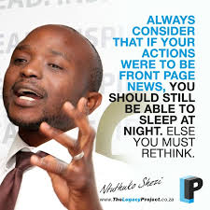
NTUTHUKO SHEZI
Founder & CEO at Livestock Wealth.
A crowd farming platform that allows anyone to be a farmer by providing:
Loans.
Medical insurance.
Life insurance.
Tertiary Education:
Bachelor of Science in Electro-Mechanical Engineering.
Certificate in Business and Entrepreneurship.
Holder of three honors and awards.

Slide 6
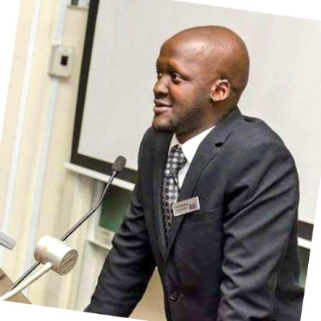
KARIDAS TSHINTSHOLO
Founder of Khula! App.
Founded Moneytree Group at 18 years of age.
It is a business and agricultural app.
Executive Director of Moneytree Group.
A media, publishing and marketing business with a key focus on the youth and emerging markets/segments of the economy.
Has won two honors and awards.
Tertiary Education:
Commerce.

Slide 7
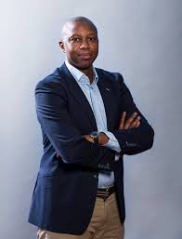
KATLEGO MAPHAI
Co-founder and Chief Executive Officer at Yoco.
An African fintech venture that builds tools and services to help small businesses get paid, run their business better, and grow.
Seeks to empower and grow individuals and businesses.
Tertiary Education:
Bachelor of Business Science, Information Systems.

Slide 8
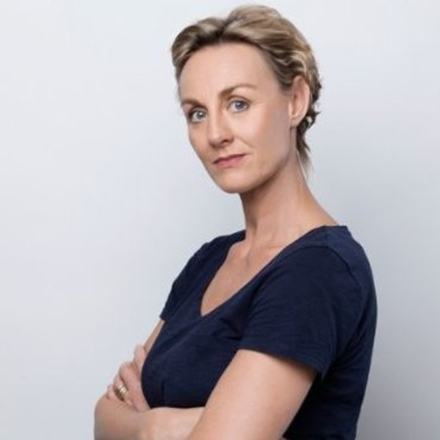
JENNY LESLIE
Chief Operating Officer & Co-Founder Biotech Africa.
The company manufactures recombinant proteins.
Tertiary Education:
BSc Hons (1st) Microbiology.
PhD Virology, Microbiology, Molecular Microbiology and Information Technology.
Also good at Web Design.

Slide 9
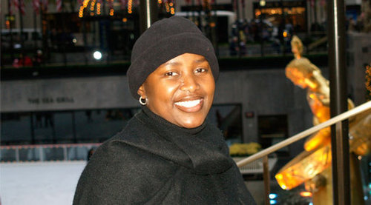
SIBONGILE SAMBO
Founder and managing director of SRS Aviation.
The first 100% black female owned aviation company that offers clients professional and personalized flight options to destinations around the world.
Also a business-based motivational speaker.
Tertiary Education:
Bachelor of Administration Honors, Industrial and Organizational Policy.

Slide 10
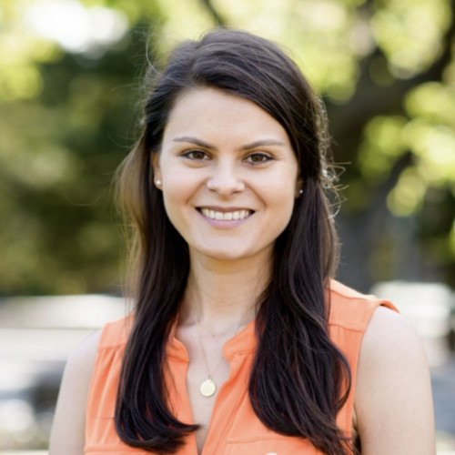
MELISSA MCCOY
Product Manager at Google.
Passionate about creating and using technology to improve livelihoods.
Tertiary education:
BS Chemical Engineering.
MSc Computer Science.
Masters of Business Administration(MBA).

Slide 11
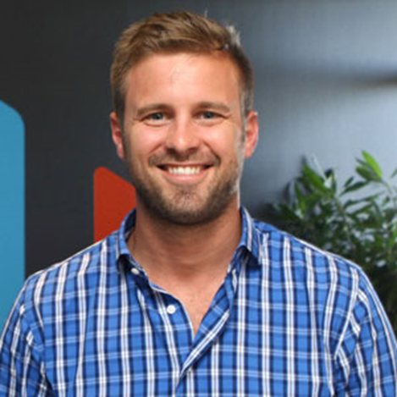
BEVAN DUCASSE
Founder and Chief Executive Officer – wiGroup.
The Leading software as a service provider in loyalty, vouchering, rewards and mobile commerce.
Tertiary Education:
B.Comm, Financial Analysis.

Slide 12
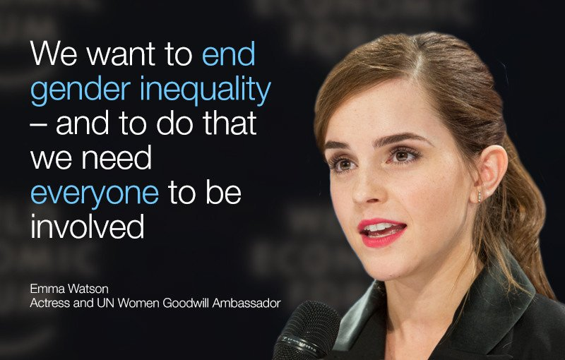
Presentation by,
Pauline Brown.

